Slide 1
Growing as a Disciple

Slide 2
Levels of Maturity
Level 1 – Infant
Level 2 – Child
Level 3 – Teen
Level 4 - Adult

Slide 3
Levels of Maturity
Level 1 Christian - Infant
New Christian
Needs: protection – from Satan, discouragement, confusion, doubts, cults
How we help: Provide Protection, Love, Basic Knowledge

Slide 4
Levels of Maturity
Level 2 Christian - Child
More is required of the Level 2 Christian / child
Discipline and accountability are added into the life
Begins to learn what it means to be a citizen of the Kingdom of God
Needs: help every step of the way, examples
How we help: Provide Consistent, strong guidance

Slide 5
Levels of Maturity
Level 3 Christian - Teen
Increased responsibilities, including teaching
Needs: breathing room to try and fail
How we help: Provide opportunities to grow strength, responsibility, experience

Slide 6
Levels of Maturity
Level 4 Christian - Adult
Full Responsibility and Reproduction
Develops ever-deepening commitment to the Lord
Produces greater fruit for the Lord
Greatest dependence is on the Lord, not man, the world, or self
Needs: develop an intense desire for a close walk with the Lord
How we help: Provide opportunities to grow leadership ability, self-discipline

Slide 7
Paradigm Shifts in Disciplemaking
Leaders of God’s people who approach the challenges facing the next generation of the church with a casual complacency, rather than a passionate urgency, greatly miscalculate the dangers that lurk ahead – Richard Dunn

Slide 8
Paradigm Shifts in Disciplemaking
How do we take the people God has brought to the church and empower and equip them to go into the world as disciplemakers who will lead others to know and follow Christ – Alan Hirsch
The Great Lie – “My life does not have much to offer – I am simply inadequate when it comes to making a difference in the life of others”

Slide 9
The Aspects of Being a Disciple
Acts 2:42 - They were continually devoting themselves to the apostles’ teaching and to fellowship, to the breaking of bread and to prayer.
Mission / Evangelism
Study
Prayer
Fellowship
Worship

Slide 10
Essentials for Disciples
Bible reading (2 Tim 3:16-17, Matt 4,4)

Slide 11
Essentials for Disciples
Individual and Corporate Worship (Col 3:16, Heb 12:28-29)

Slide 12
Essentials for Disciples
Individual and Corporate Prayer (Matt 6:9-13, Acts 1:14)

Slide 13
Essentials for Disciples
Serving (1 Peter 4:10, Col 3:23-24)

Slide 14
Essentials for Disciples
Stewardship (Psalm 24:1, Gen 39:4, Luke 12:42-43)

Slide 15
Essentials for Disciples
Evangelism (Matt 28:19-20, Rom 10:14)

Slide 16
Essentials for Disciples
Spiritual Disciplines (1 Tim 4:7-8, Heb 12:11)

Slide 17
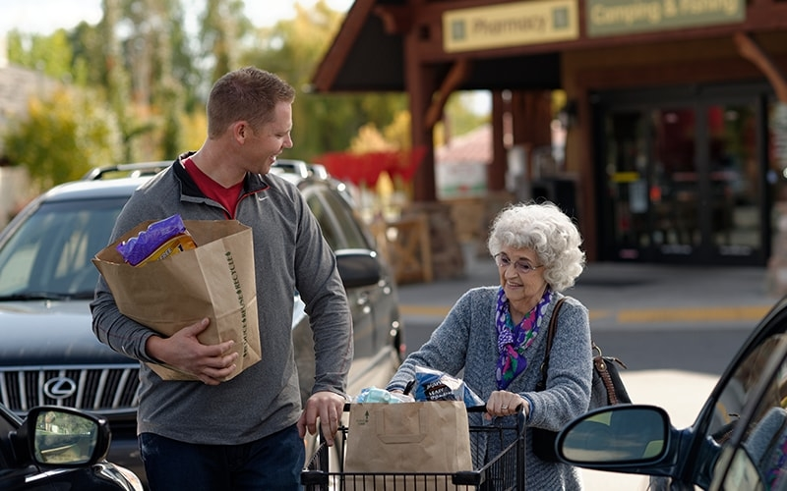
Essentials for Disciples
Loving People (John 13:34, Eph 4:2)

Slide 18
Essentials for Disciples
Bible Reading
Individual and Corporate Worship
Individual and Corporate Prayer
Serving
Stewardship
Evangelism
Spiritual Disciplines
Loving People
#

